Slide 1

















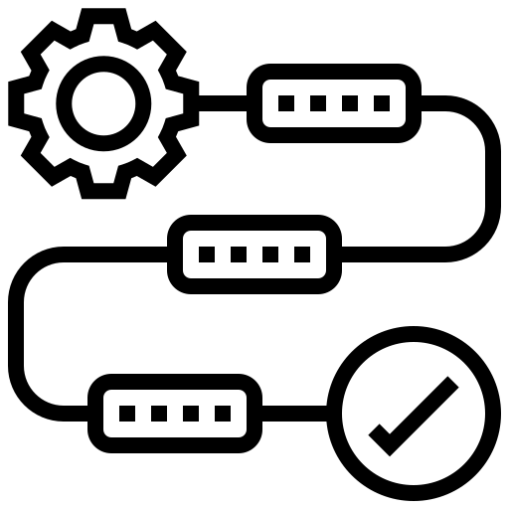

PHISHING WEBSITE DETECTOR APP USING ANDROID STUDIO (ADDRESS BAR BASED FEATURES)
Coding
Conclusion
Demo
Work Flow
Introduction
Title
Result
Snap
Module
Method
Literature
Software
Real time
Hardware
Members
Testing
Architecture
Limitations
Novelty

Slide 2
PROJECT TEAM MEMBERS:
20BCY10065 Yogendra Bijapur
20BCY10104 Joel Franko
20BCY10129 R.P. Niranjan Surya Prasad
20BCY10177 Rohan Kolhatkar
Coding
Introduction
Conclusion
Demo
Work Flow
Limitations
Title
Result
Snap
Module
Method
Members
Literature
Software
Real time
Testing
Hardware
Architecture
Novelty
GUIDE:
DR. GANESHAN R

Slide 3
Introduction:
Phishing is an attack wherein the attacker exploits social engineering techniques to perform identity theft. Phishing traditionally functions by sending forged e-mail, mimicking an online bank, auction or payment sites, guiding users to a bogus web page which is carefully designed to look like the login to the genuine site. Phishing aims to collect sensitive and personal information such as usernames, passwords, credit card numbers, and even money by impersonating a legitimate entity in the cyber space.
Coding
Conclusion
Work Flow
Title
Result
Demo
Method
Introduction
Snap
Module
Literature
Software
Real time
Testing
Hardware
Limitations
Architecture
Novelty
Members

Slide 4
Existing work:
Phishing detector websites.
Phishing detection and response softwares.
Limitations:
Phishing detection techniques do suffer low detection accuracy and high false alarm especially when novel phishing approaches are introduced.
In the internet most of the phishing detector websites are fake and they ask to sign up to scan.
Coding
Conclusion
Work Flow
Introduction
Result
Demo
Method
Title
Snap
Module
Literature
Software
Real time
Hardware
Members
Testing
Architecture
Novelty
Limitations

Slide 5
Proposed work and methodology:
We propose to create an app which will helps to detect such URLs based upon some check conditions.
Our idea is to provide an app which is easy to use and doesn’t require any internet connectivity.
This app is based on the address bar features for the detection of the phishing url.
This app can help people detect the phishing url before clicking it.
Coding
Conclusion
Work Flow
Introduction
Result
Demo
Title
Snap
Module
Literature
Software
Real time
Hardware
Members
Testing
Limitations
Architecture
Novelty
Method

Slide 6
Novelty:
Our app works offline doesn’t require an internet connection. Therefore, it doesn’t store any data.
This app is easy to use and reliable.
It has high phishing detection accuracy for web address bar features.
This app is safe to use. Since it doesn’t store any data, it is not vulnerable to attacks.
Coding
Conclusion
Work Flow
Introduction
Demo
Real time
Title
Result
Snap
Module
Method
Literature
Software
Hardware
Members
Testing
Limitations
Architecture
Novelty

Slide 7
Real time usage:
This app helps every user to be aware of Phishing websites and helps the user to protect the data.
It will help us to understand the characteristics of phishing websites well. Therefore, in the future when we come across one we won’t be needing any tools to distinguish it.
Once when the user entered the suspected URL in the app, It scans and shows the results.
This app is very safe and friendly to use.
Coding
Conclusion
Work Flow
Introduction
Demo
Hardware
Title
Real time
Result
Snap
Module
Method
Literature
Software
Members
Testing
Architecture
Limitations
Novelty

Slide 8
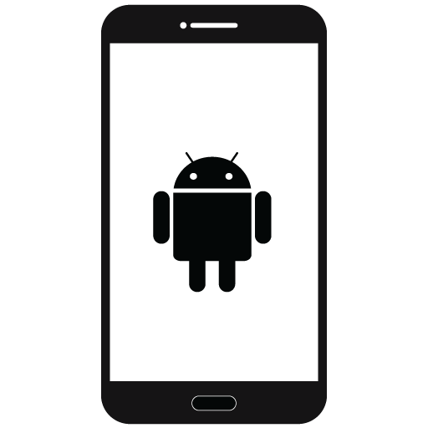
Android phone:
Coding
Conclusion
Work Flow
Introduction
Demo
Title
Hardware
Result
Snap
Module
Method
Literature
Software
Real time
Members
Testing
Architecture
Limitations
Novelty

Slide 9

Android studio:
Coding
Conclusion
Work Flow
Introduction
Demo
Title
Hardware
Result
Snap
Module
Method
Literature
Real time
Software
Members
Testing
Architecture
Limitations
Novelty

Slide 10
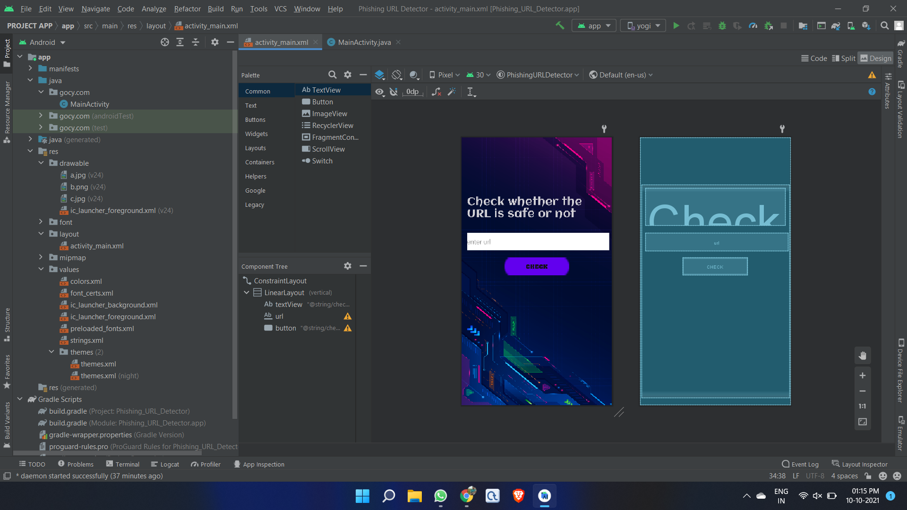
Coding
Conclusion
Work Flow
Introduction
Demo
Title
Hardware
Result
Snap
Module
Literature
Method
Real time
Software
Members
Testing
Limitations
Architecture
Novelty
Design
Blueprint

Slide 11
Quick summary of what we have seen:
First and foremost, a quick dive-in to the meaning of phishing in details to enlighten on why phishing is an important area of research is given;
Second, different existing anti-phishing approaches are examined in terms of accuracy and limitations;
Third, a brief acknowledgment of existing techniques and how these techniques serve as a baseline to our research is presented.
Fourth, Implementation of our ideas and modules into an working app.
Coding
Conclusion
Work Flow
Introduction
Demo
Title
Hardware
Result
Snap
Module
Method
Real time
Software
Literature
Members
Testing
Limitations
Architecture
Novelty

Slide 12
ADDRESS BAR BASED FEATURES:
Long URL to Hide the Suspicious Part: To ensure accuracy of our study, we calculated the length of URLs in the dataset and produced an average URL length. The results showed that if the length of the URL is greater than 75 characters then the URL classified as phishing.
Using the IP Address: If an IP address is used as an alternative of the domain name in the URL, such as “http://125.98.3.123/fake.html”, users can be sure that someone is trying to steal their personal information.
Dots: A secure web-page link contains at most 4 dots. If perhaps, there are more than 4 dots in a web page then it may be recognized as a phishing link. For example : http://www.website1.com.my/www.phish.com/index.php
Conclusion
Coding
Work Flow
Introduction
Demo
Title
Hardware
Module
Result
Snap
Method
Real time
Literature
Software
Members
Testing
Limitations
Architecture
Novelty

Slide 13
ADDRESS BAR BASED FEATURES:
URL’s having “@” Symbol: The phishing URL may include the “@” symbol because the web browser, ignore everything to the left of the @ symbol, therefore, the address ebay.com@fake-auction.com would actually be “fake-auction.com.”
Redirecting using “//”: The existence of “//” within the URL path means that the user will be redirected to another website. URL should no contain it more than 2 times.
Adding Prefix or Suffix Separated by (-) to the Domain: The dash symbol is rarely used in legitimate URLs. Phishers tend to add prefixes or suffixes separated by (-) to the domain name so that users feel that they are dealing with a legitimate webpage. For example: http://www.Confirme-paypal.com/.
Conclusion
Coding
Work Flow
Introduction
Demo
Title
Hardware
Result
Snap
Method
Real time
Literature
Module
Software
Members
Testing
Limitations
Architecture
Novelty

Slide 14
ADDRESS BAR BASED FEATURES:
URL using word ‘tiny’: URL must not contain the word tiny in it. If it contains it might be phishing.
The Existence of “HTTPS” Token in the Domain Part of the URL: The phishers may add the “HTTPS” token to the domain part of a URL in order to trick users. For example: http://https-www-paypal-it-webapps-mpp-home.soft-hair.com/.
Conclusion
Coding
Work Flow
Introduction
Demo
Title
Hardware
Result
Snap
Method
Real time
Literature
Module
Software
Members
Testing
Limitations
Architecture
Novelty

Slide 15
Enter the URL
Enter the URL
Compare 8 condition with URL
Coding
If URL satisfice 3 or more condition
Work Flow
Conclusion
Introduction
Demo
Title
Hardware
Result
Snap
Method
Real time
Literature
Module
Software
Members
Testing
Limitations
Architecture
Novelty
YES
NO
URL is PHISHING
URL is SAFE

Slide 16
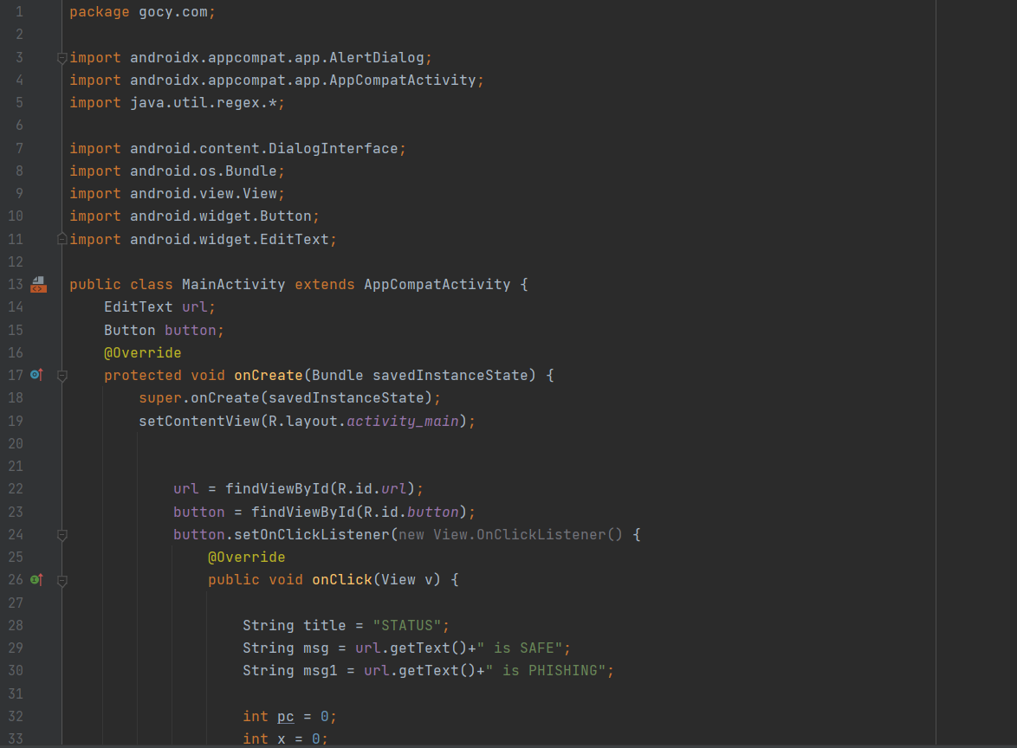
JAVA
Work Flow
Coding
Conclusion
Introduction
Demo
Title
Hardware
Result
Snap
Method
Real time
Literature
Module
Software
Members
Testing
Limitations
Architecture
Novelty

Slide 17
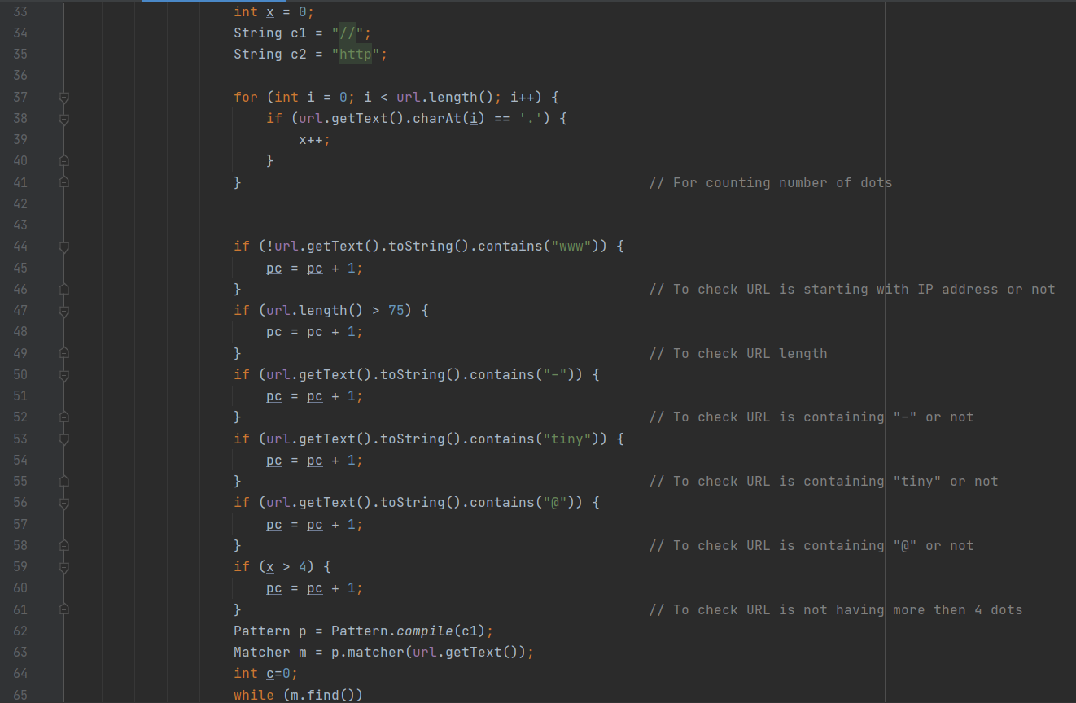
JAVA
Work Flow
Coding
Conclusion
Introduction
Demo
Title
Hardware
Result
Snap
Method
Real time
Literature
Module
Software
Members
Testing
Limitations
Architecture
Novelty

Slide 18
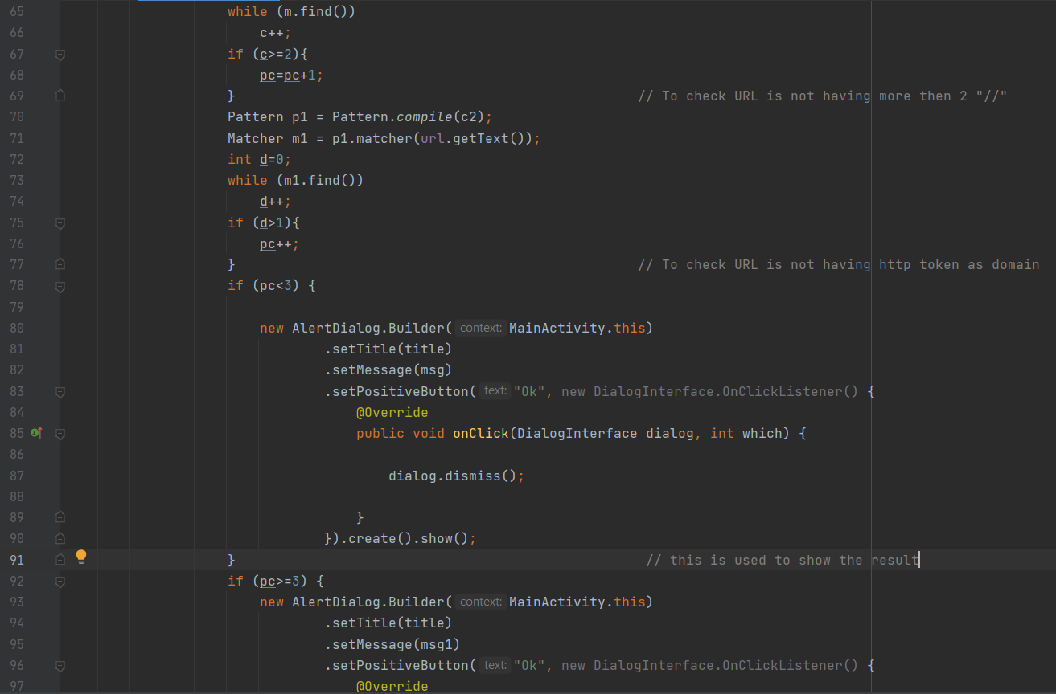
JAVA
Work Flow
Coding
Conclusion
Introduction
Demo
Title
Hardware
Result
Snap
Method
Real time
Literature
Module
Software
Members
Testing
Limitations
Architecture
Novelty

Slide 19
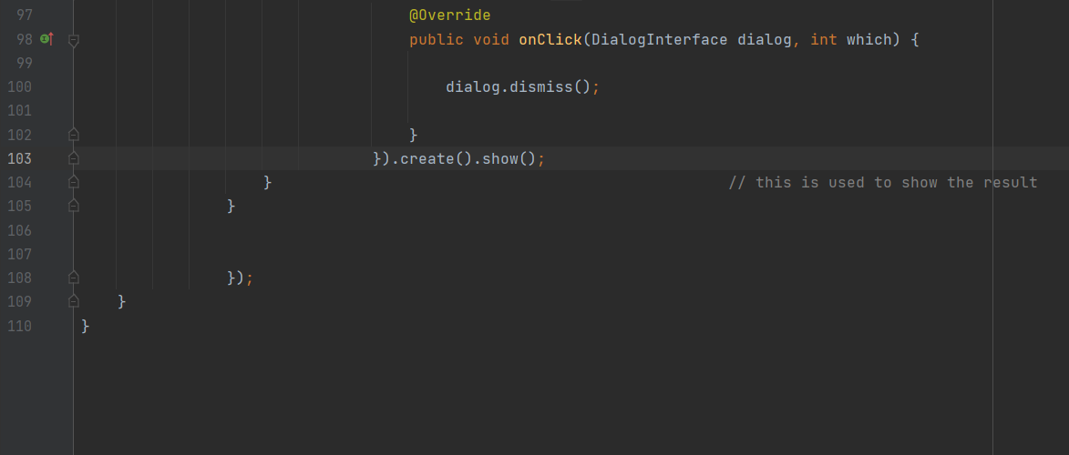
JAVA
Work Flow
Coding
Conclusion
Introduction
Demo
Title
Hardware
Result
Snap
Method
Real time
Literature
Module
Software
Members
Testing
Limitations
Architecture
Novelty

Slide 20
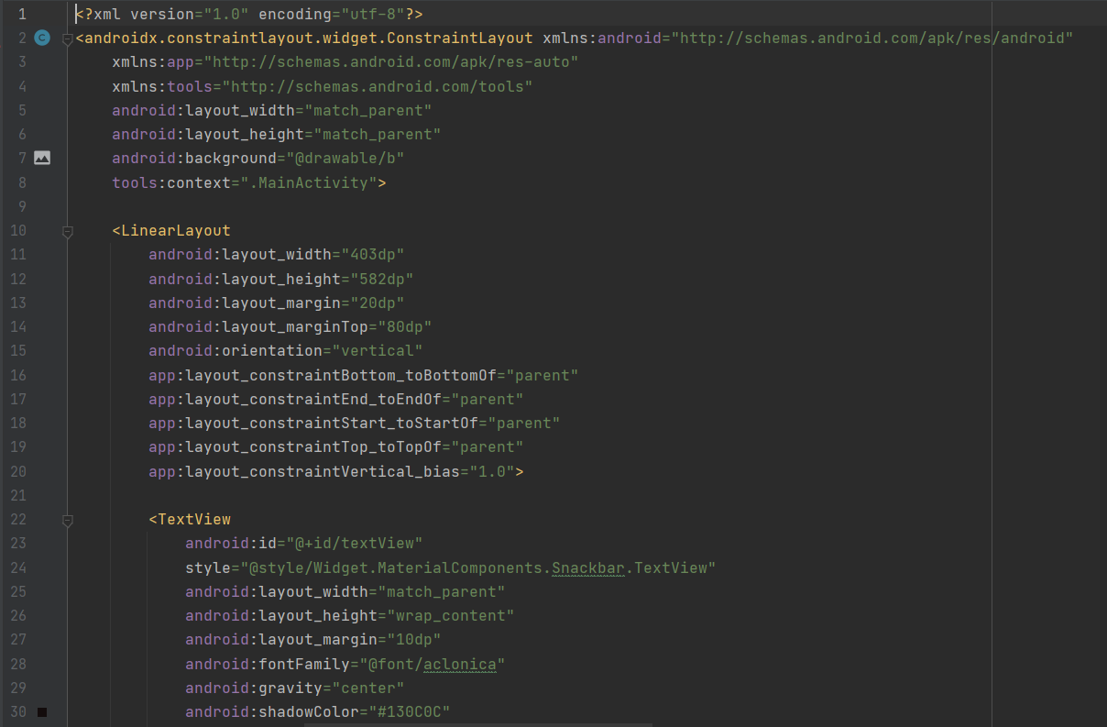
XML
Work Flow
Coding
Conclusion
Introduction
Demo
Title
Hardware
Result
Snap
Method
Real time
Literature
Module
Software
Members
Testing
Limitations
Architecture
Novelty

Slide 21
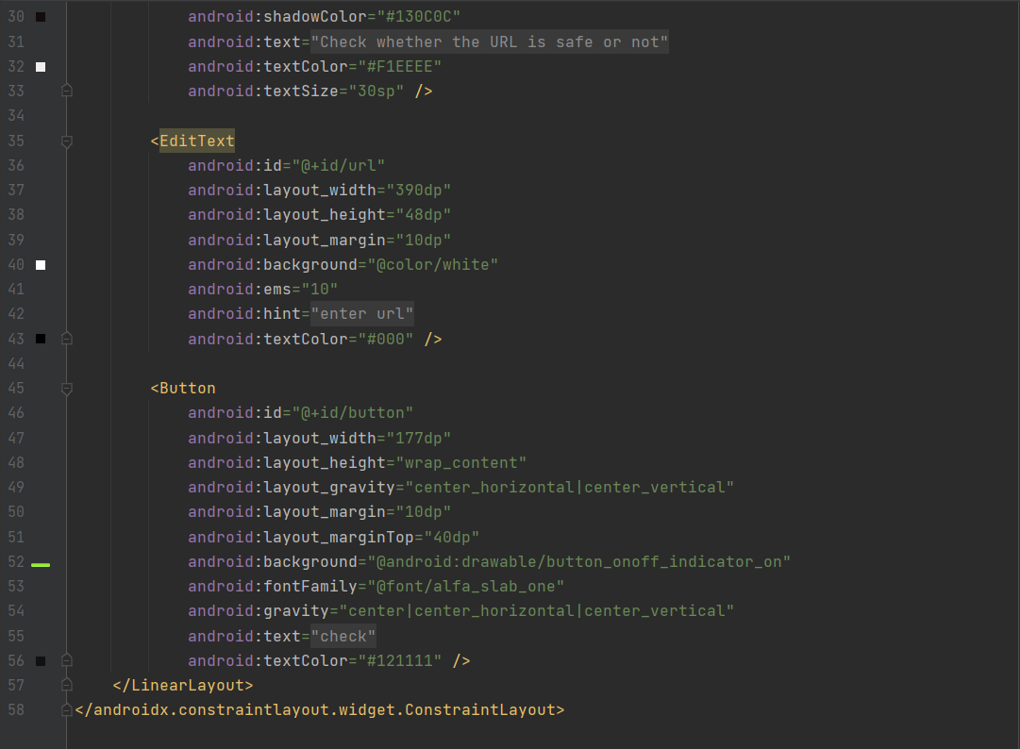
XML
Work Flow
Coding
Conclusion
Introduction
Demo
Title
Hardware
Result
Snap
Method
Real time
Literature
Module
Software
Members
Testing
Limitations
Architecture
Novelty

Slide 22
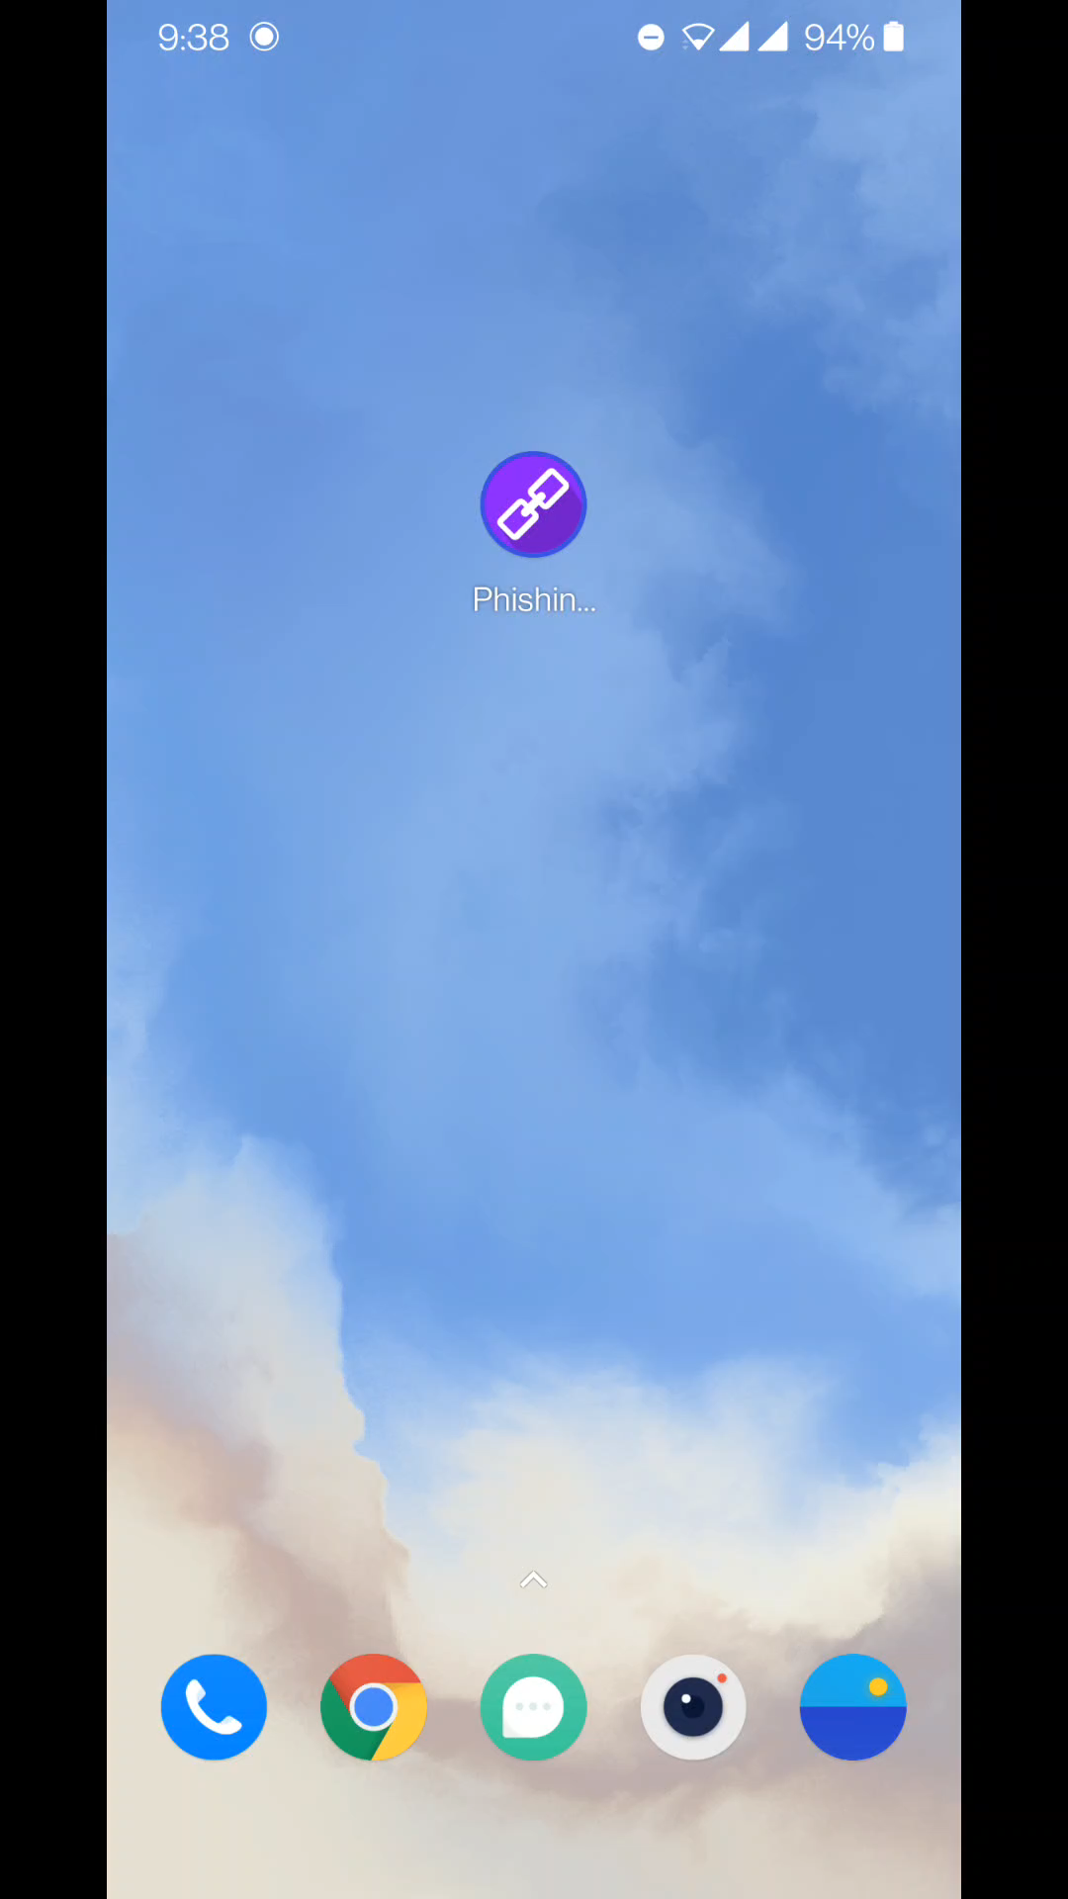
Work Flow
Coding
Conclusion
Introduction
Title
Demo
Hardware
Result
Snap
Method
Real time
Literature
Module
Software
Members
Testing
Limitations
Architecture
Novelty

Slide 23
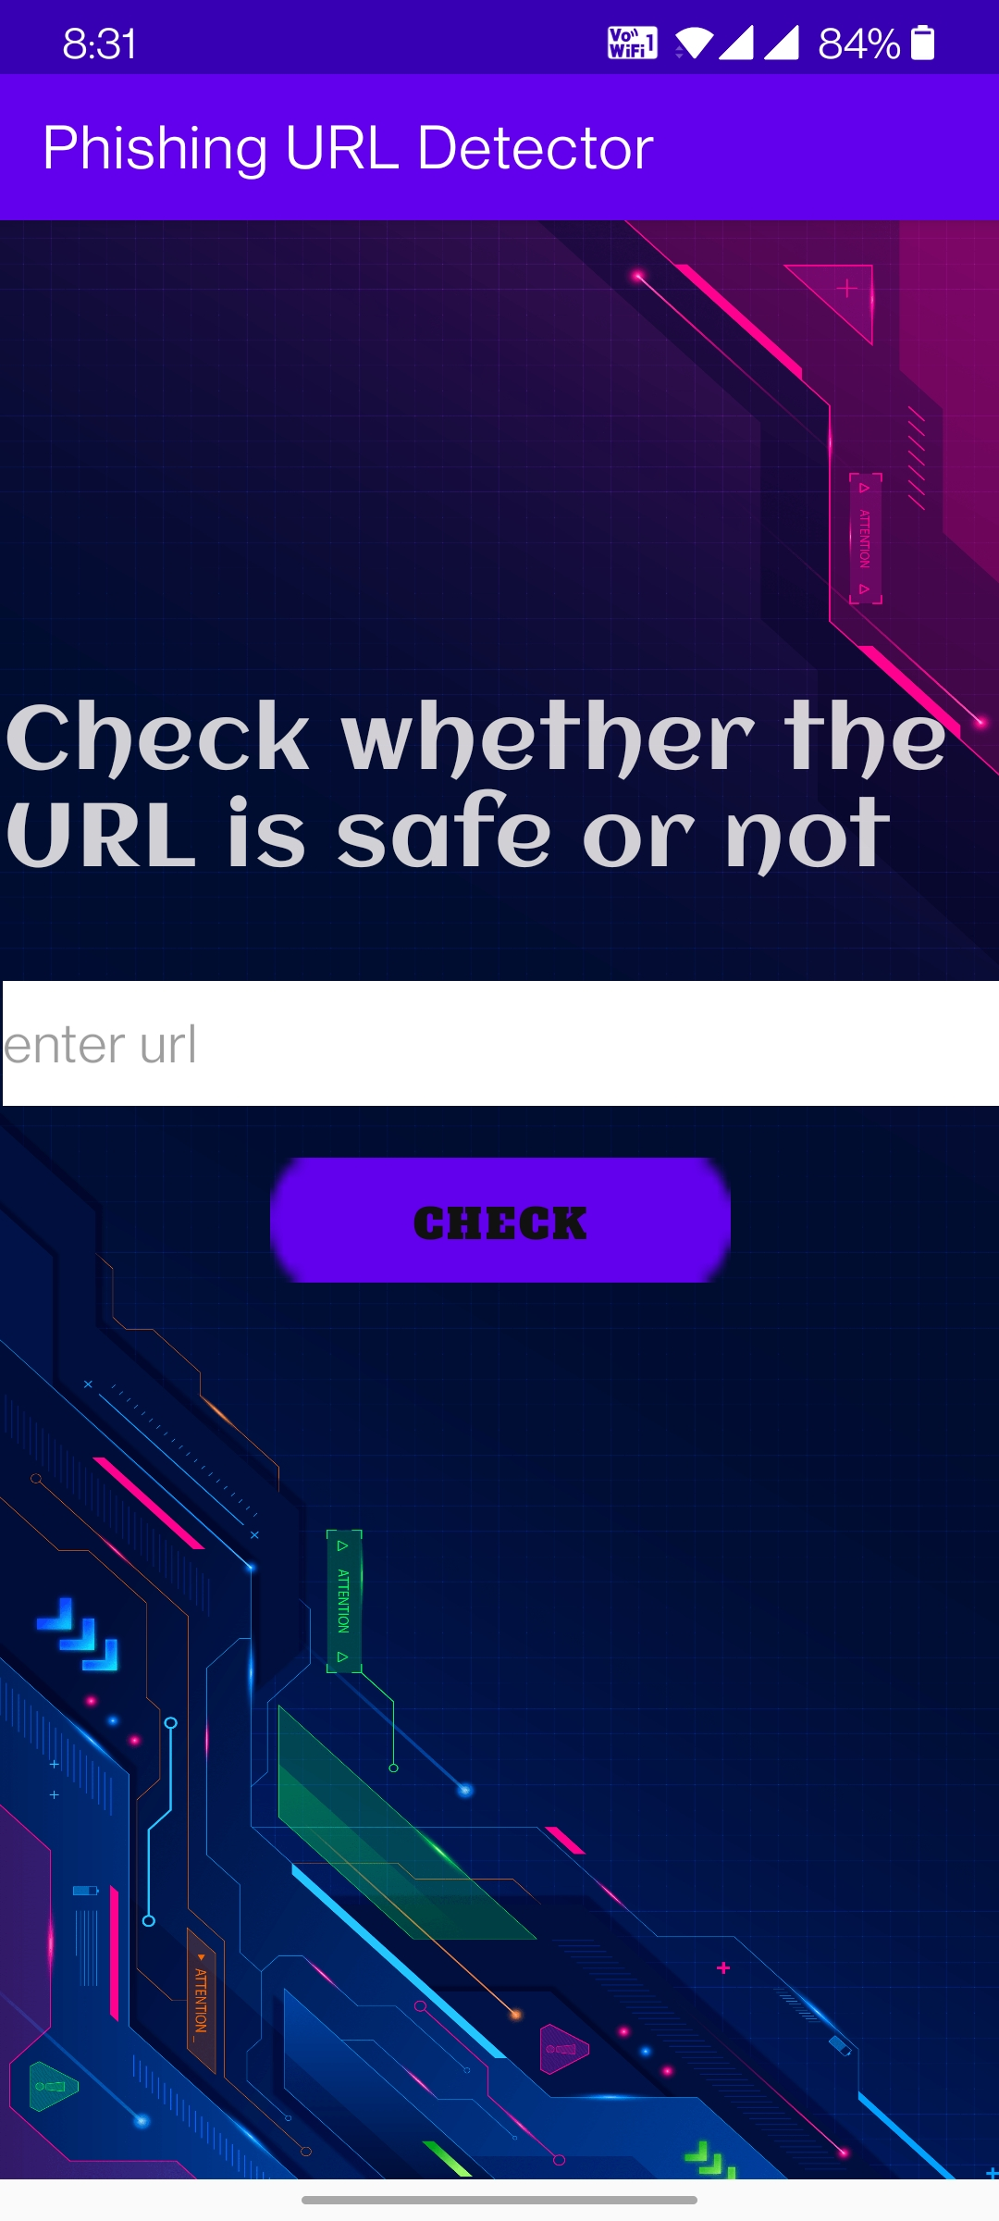
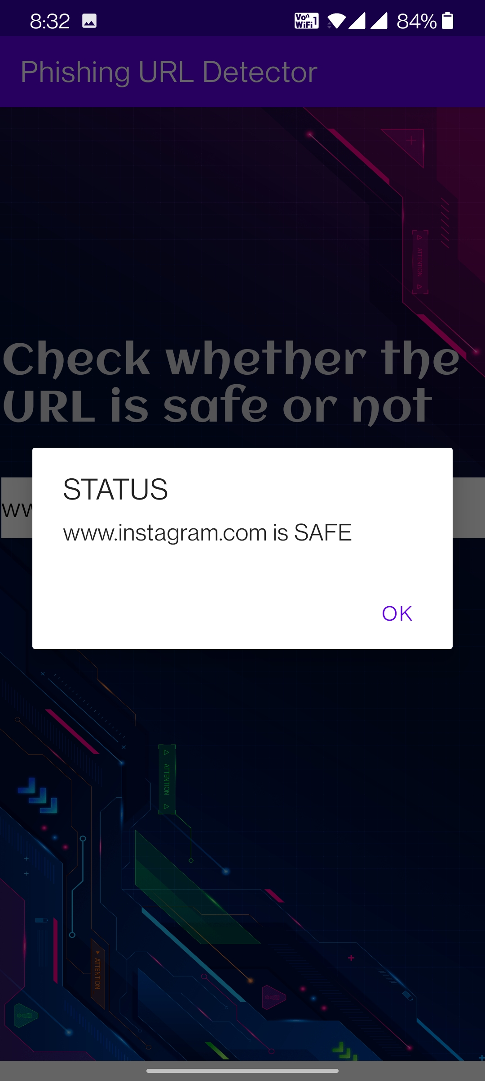

Work Flow
Coding
Conclusion
Introduction
Title
Demo
Hardware
Result
Method
Real time
Literature
Module
Software
Snap
Members
Testing
Limitations
Architecture
Novelty

Slide 24
Live demo:
Work Flow
Coding
Conclusion
Introduction
Title
Demo
Hardware
Result
Method
Real time
Literature
Module
Software
Snap
Members
Limitations
Testing
Architecture
Novelty

Slide 25
Input | Output
alissonluis-musico.sites.uol.com.br/mar.jpg | Phishing
dl01.faddmr.com/n/e176d94e-d9b7-11e2-a752-00259033c1da/Setup.exe?tid=102dccc4aa5799d2efb748b9dd0e4fFake | Phishing
6b8a953b2bf7788063d5-6e453f33ecbb90f11a62a5c376375af3.r71.cf5.rackcdn.com/Videos%20Player.mp4.exe | Phishing
https://vitbhopal.ac.in | Safe
hydraulicpowerpack.com/BANK.STORAGE.DATA/payment-document.html | Phishing
https://www.onlinesbi.com | Safe
Work Flow
Coding
Conclusion
Introduction
Title
Demo
Result
Hardware
Method
Real time
Literature
Module
Software
Snap
Members
Limitations
Testing
Architecture
Novelty

Slide 26
Conclusion:
The importance to safeguard online users from becoming victims of online fraud, phishing detection tools play a vital role in ensuring a secure online experience for users. Unfortunately, many of the existing phishing detection tools, especially those that depend on an existing blacklist, suffer limitations such as low detection accuracy and high false alarm. The inconsistent nature of attacks behaviors and continuously changing URL phish patterns require timely updating of the model.
Work Flow
Coding
Introduction
Conclusion
Title
Demo
Hardware
Method
Real time
Literature
Module
Software
Result
Snap
Members
Limitations
Testing
Architecture
Novelty

Slide 27
Thank you

